Slide 1
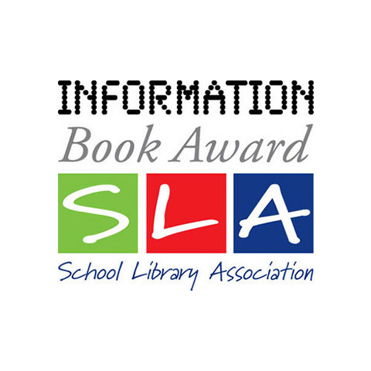
The School Library Association’s Information Book Award 2023

Slide 2
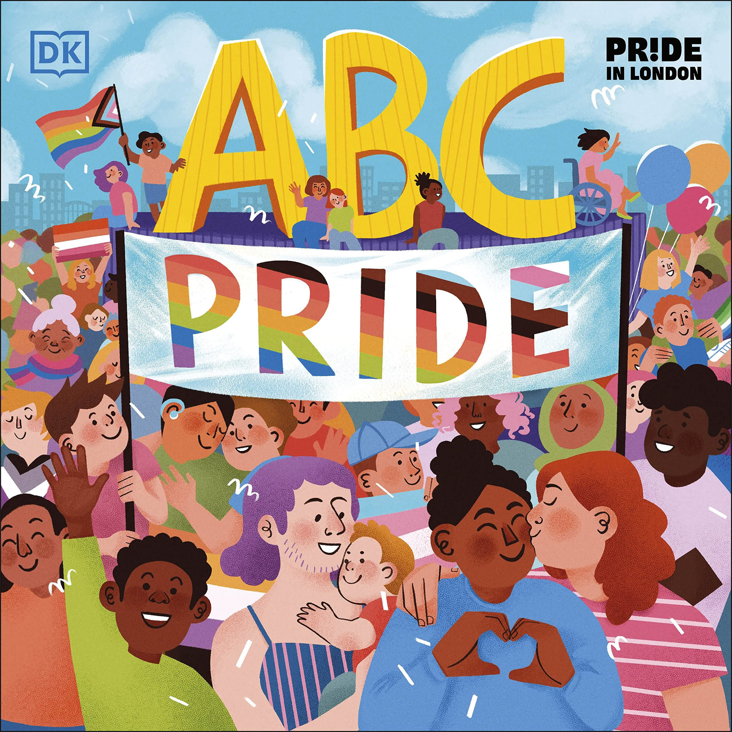
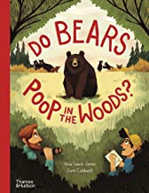
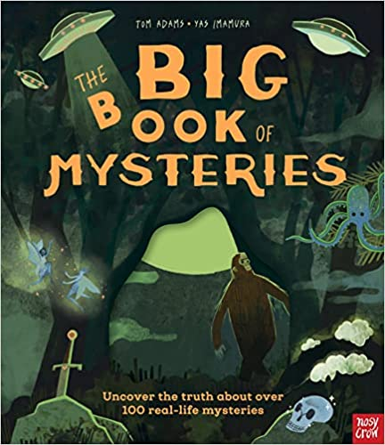
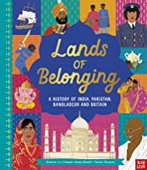
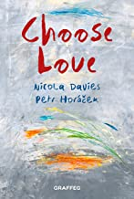
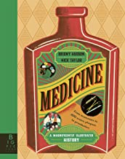
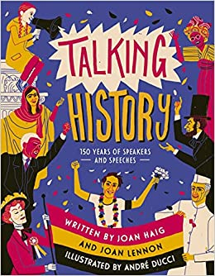
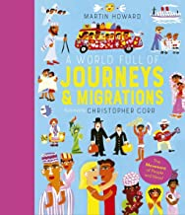
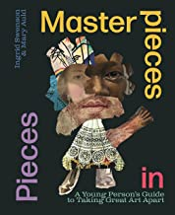
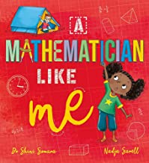
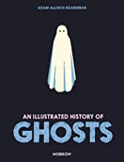
What’s it all about?
The Information Book Award (IBA) is all about highlighting some of the best information books published during the previous year.

Slide 3
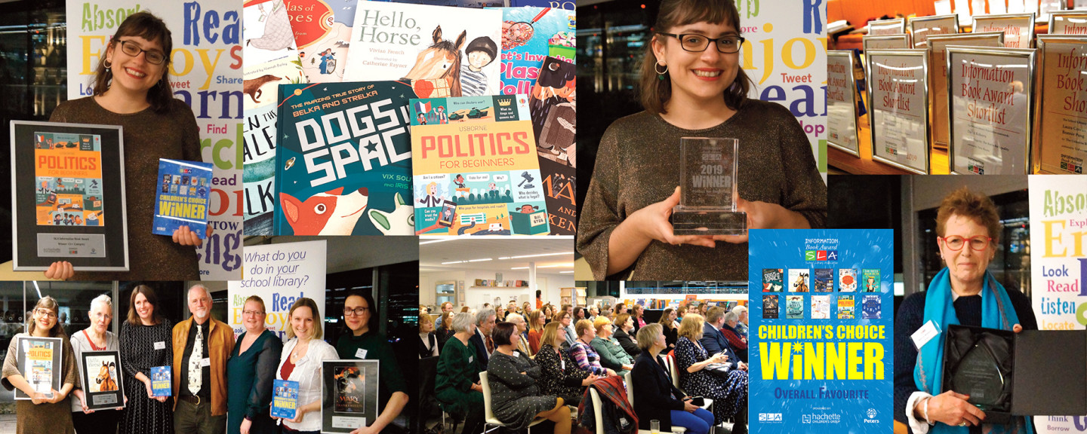
Who decides?
As well as a panel of adult judges, children and young people are invited to vote for their choices.
The results are always interesting to compare – sometimes they match, and sometimes they don’t!

Slide 4
Criteria
But how are you going to decided which is the best book – what criteria will you use to judge the books?
Criteria are the standards or measurements we use to judge something
Such as the temperature (hot, cold, just right) or taste (salty, sweet, just right) of porridge

Slide 5
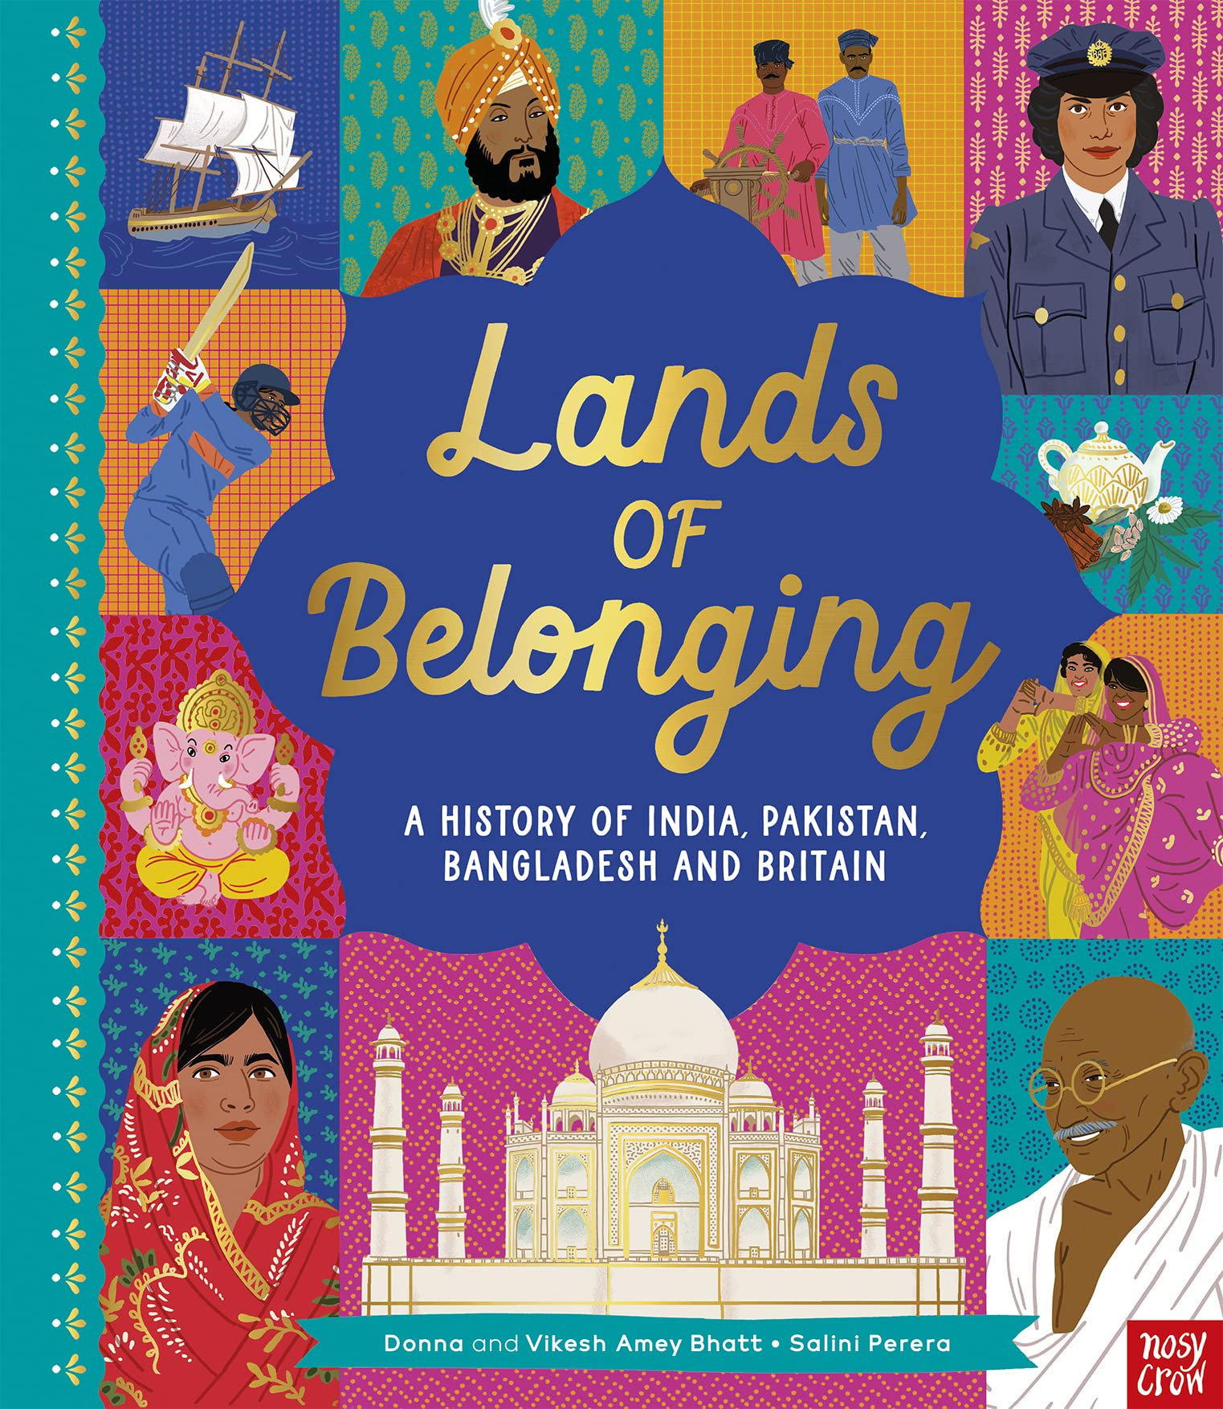
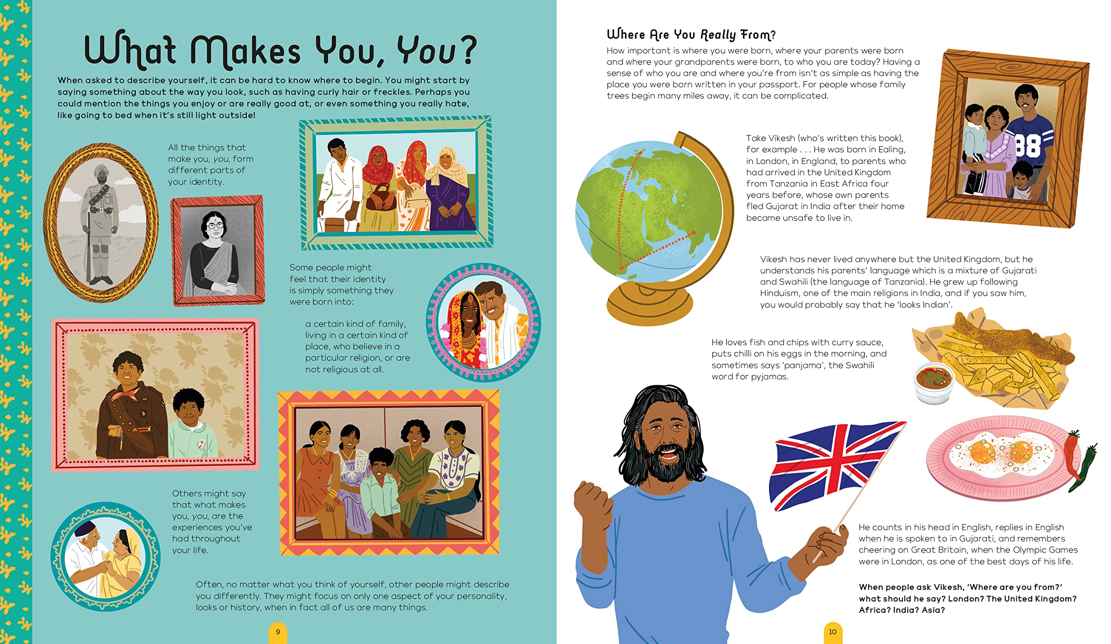
How does the book look?
First impressions are important: the cover, endpapers, design and layout, typography and illustrations.
All of these features can have an immediate visual impact.

Slide 6
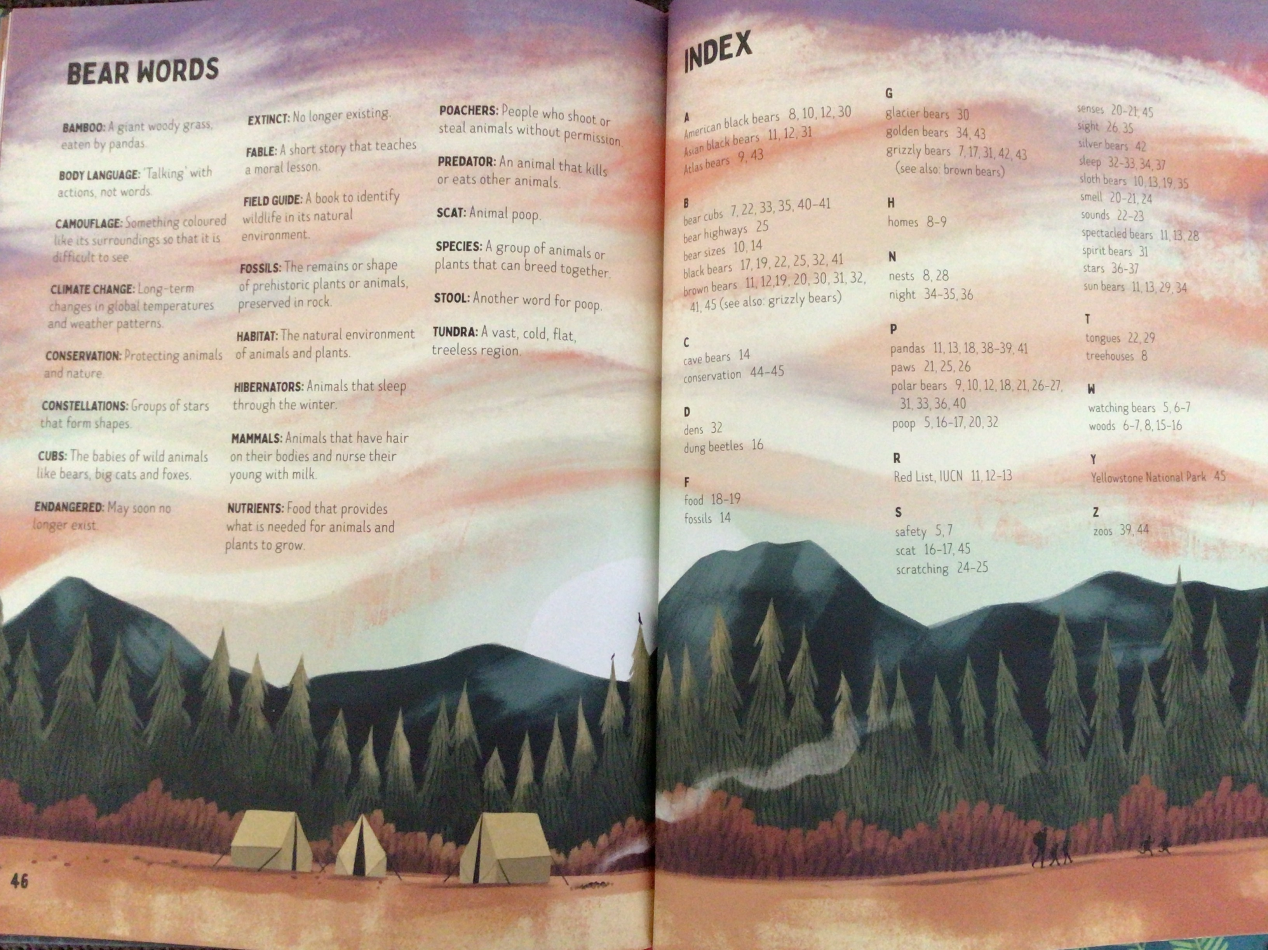
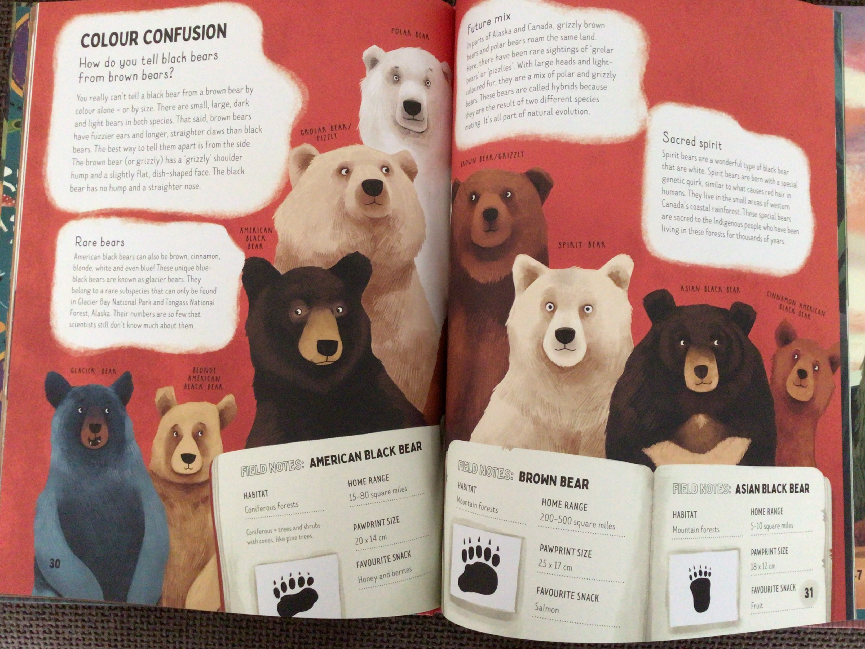
How is information organised?
How does the book help you to locate information quickly? Does it have a contents page, index or glossary?
How is the information presented on each page? Does the book make use of headings? Is the text divided into easier-to-read chunks?

Slide 7
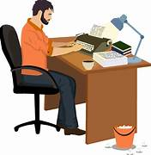
How is well is the book written?
Is the language used familiar and easy to read?
Are new or technical words explained?
Is there a sense of the author’s voice in the style of writing?
Chatty
Humorous
Informative
Questioning
Challenging

Slide 8
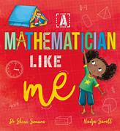
Appeal of the subject?
Is the subject or topic likely to be of general interest? Would it appeal to anyone in particular you know?
Does the blurb or the introduction make you want to keep reading?
Has the book sparked your curiosity to find out more about the subject or to look out for other books by the same author?

Slide 9
Reliability and accuracy of the information?
How can you check the up-to-date-ness and accuracy of the information?
Date of publication
Evidence of the author’s subject knowledge
Use of a consultant or fact checker
The adult judges sometimes invite experts to check certain books for accuracy. Perhaps you could ask a teacher or librarian for their opinion.

Slide 10
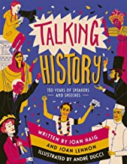
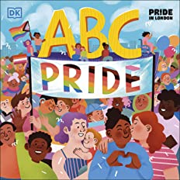
Originality?
Does the book take a completely different approach to a familiar subject?
Does the book explore a new or rarely covered subject?

Slide 11
Discussing the books
Having had a close look at the books, the adult judges get together to discuss each shortlist and come to an agreement about which book is the best.
Perhaps you could discuss the books with a friend, a small group, or even the whole class!

Slide 12
One final question
One final question to help you decide!
Imagine you only have enough money to buy one of the shortlisted books for your school library, which would it be and why?

